Slide 1
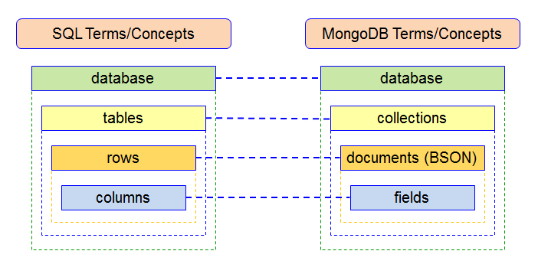
Mapping Relational Databases to MongoDB
Collections in MongoDB is equivalent to the tables in RDBMS.
Documents in MongoDB is equivalent to the rows in RDBMS.
Fields in MongoDB is equivalent to the columns in RDBMS.
Fields (key and value pairs) are stored in document, documents are stored in collection and collections are stored in database.

